Slide 1
Learnings From the Articles of Digital Entrepreneurship
Dr. S. K. Majumdar

Slide 2
Salient Points of Article 5
This Article answer One Critical Question:
What Entrepreneurs Get Wrong?

Slide 3
Salient Points of Article 5
Common Mistakes of Most Entrepreneurs Do:
Starting Late (Customer Discovery at WIP Stage)
Failing to Listen (Ignoring Adverse Feedback)
Offering Heavy Discount to Get 1st Order
Selling to Family and Friends
Failing to seek strategic Buyers
Failing to face tough questions:
Failing to offer samples, Establishing Credibility,
Defending the Small and Calculating Pricing
Removing doubts about Switching Costs
WIP = Work in Progress
Finding WTP & Buyer are the Critical Factors of Success

Slide 4
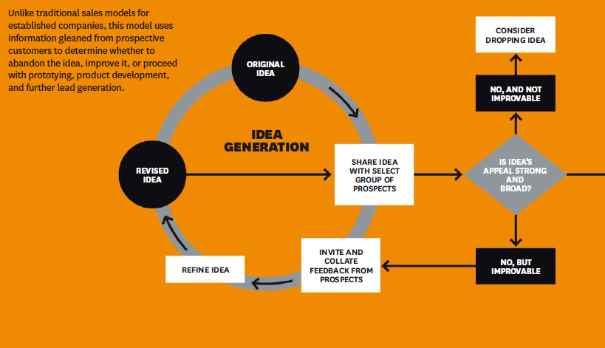
Entrepreneur-Friendly Sales Model

Slide 5
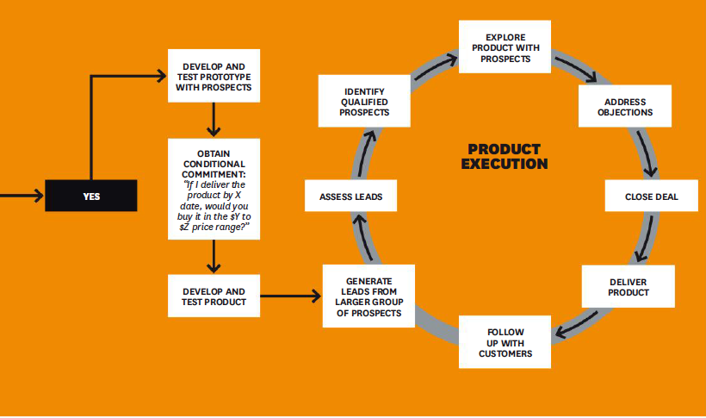
Entrepreneur-Friendly Sales Model

Slide 6
Lifecycle Model of Digital Entrepreneurship
Customer Discover + Findings of Ways of Wining
Finding WTP & Buyer are the Critical Factors of Success
Driving
Innovation
Radical
Process Innovation
Design Thinking
The Iterative Front End of Digital Entrepreneurship
Concept
Business Development
Platform
Innovation
Design Criteria
Prototype
Market Entry
Idea
Digital
Platform
Enterprise Building
Customer
Discovery
Customer
Winning
Business Model Actuation
Building STAR Teams
Realigning TEAM with Growth Strategy
Vibrant Digital
Enterprise
Product/ Service Development
Business Model Development
Fight Rivalry
Sustain Growth
Platform
Up-gradation
Fuzzy Front
End of Design
Pivoting
Digital Process
Back End of Digital Entrepreneurship
S = Strategic
T = Transformational
A = Agile, and
R = Responsive
T = Task, Talents and Executive Leadership
E = Engagement and Exploration
A = Alignment and Accountability
M = Measurement and Management
Digital Ecosystems
Innovation to Orchestration to Value Optimization
Source: Dr. S. K. Majumdar

Slide 7

Thank You

